Slide 1
Innovation Framing and Innovation Adoption: A Systematic Review
BADM 504:
Scholarship in Business Administration II
Yeaji Kim
Dec 4 2023

Slide 2
Research Background
Research Motivation
Framing of innovation that innovator gives to audiences plays a vital role in the adoption of innovations due to multiple meanings and uncertainty (Rogers, 2003; Vishwanath, 2009; Weick, 1990)
Research Question
What are the factors that lead innovation framing (sense-giving) to audience’s innovation adoption (sense-making)?

Slide 3
Definitions of Keywords
Framing:
Interpretive framing (sense-making): the interpretation, packaging, and organizing of information related to a focal innovation (Giorgi, 2017; Rafaelli, Glynn, & Tushman, 2019)
Expressive framing (sense-giving): the use of rhetorical devices in communication to mobilize support and minimize resistance (Cornelissen & Werner, 2014: 185)
Innovation:
production or adoption, assimilation, and exploitation of a value-added novelty in economic and social spheres; renewal and enlargement of products, services, and markets; development of new methods of production; and establishment of new management systems. (Crossan & Apaydin, 2010, p.1155)

Slide 4
Criteria for Selection
Journal name | Count of Articles
Strategic Management Journal | 7
Organization Science | 5
Journal of Product Innovation Management | 1
Journal of Marketing Research | 1
Journal of Management Studies | 1
Journal of Communication | 1
Journal of Business Venturing | 1
Communication Monograph | 1
British Journal of Management | 1
Annual Review of Sociology | 1
Administrative Science Quarterly | 4
Academy of Management Review | 4
Academy of Management Journal | 4
Academy of Management Annals | 1
Research Policy | 1
Book Chapter | 1
Total | 35
Key words/title searching: variation of ‘framing’, ‘innovation’ & ‘evaluation’
References from the review papers
Highly cited papers (Papers that do not belong to the restricted journal list but have been cited more than 100 times based on Google Scholar Citations
Irrelevant articles based on skim-read removed

Slide 5
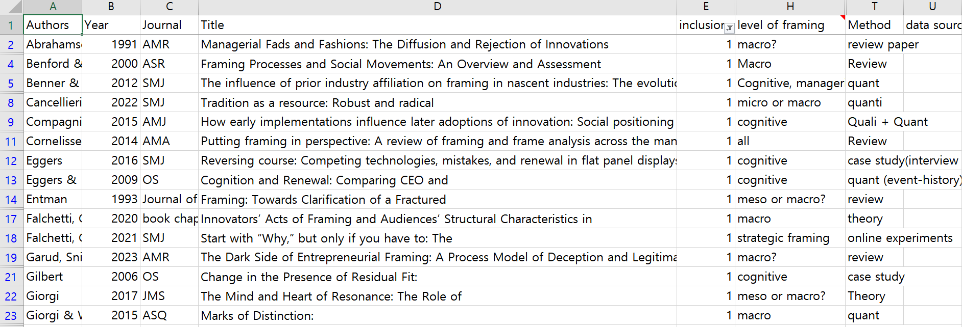
Examples of Compiled Articles

Slide 6
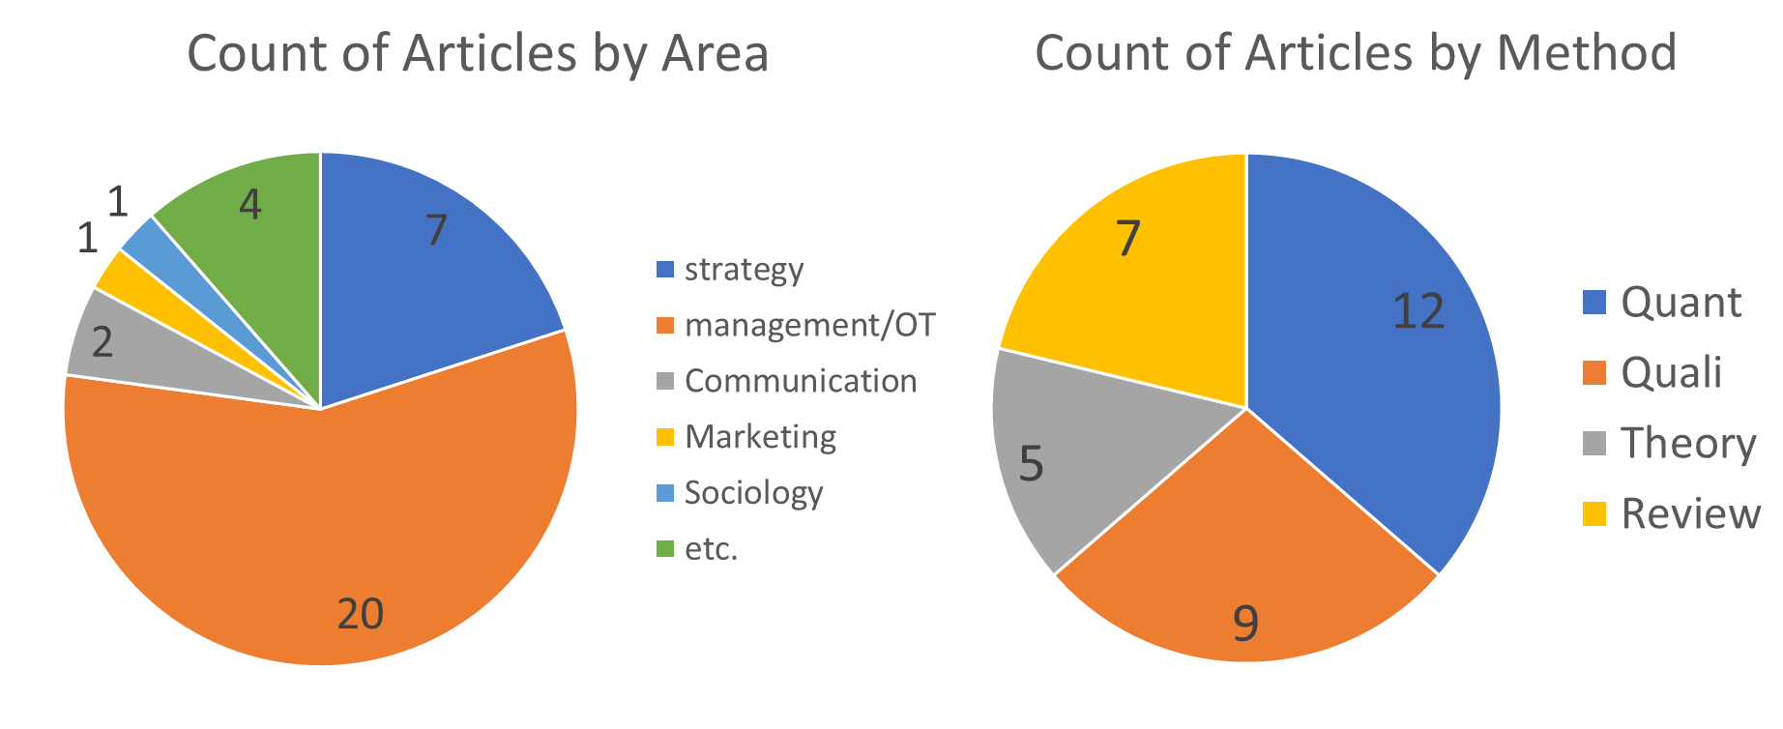
Selected Articles

Slide 7
Framework
Innovator
(Sender)
Sense-giving frame
Frame
Sense-making
Audience’s Innovation Adoption

Slide 8
Factors of Framing
Innovator
(Sender)
Sense-giving frame
Frame Sense-making
Audience’s Innovation Adoption
Sense-giving Framing
the use of rhetorical devices in communication to mobilize support and minimize resistance (Cornelissen & Werner, 2014: 185)
Factors | Type | Articles
Content | opportunity vs. threat | e.g., Vishwanath, 2009
 | Prognostic, Diagnostic, Motivation | e.g., Weber, Heinze, & DeSoucey, 2008;
 | Normalizing, Moralizing, Pragmatizing | e.g., Howard-Grenville et al., 2017
 | Uniqueness vs. Congruency | e.g., Cancellieri, Cattani, & Ferriani, 2022
Concreteness | abstract vs. concrete | e.g., Falchetti, Cattani, & Ferriani, 2021; McDonald & Gao, 2019
Consistency | consistency vs. multiplicity | e.g., Giorgi & Weber, 2015

Slide 9
Factors of Framing
Innovator
(Sender)
Sense-giving frame
Frame Sense-making
Audience’s Innovation Adoption
Sense-making Framing
the interpretation, packaging, and organizing of information related to a focal innovation (Giorgi, 2017; Rafaelli, Glynn, & Tushman, 2019)
Factors | Type | Articles
Cognition | Congruency with current frame | e.g., Giorgi, 2017
 | Future projection of innovation | e.g., Compagni, Mele, & Ravasi, 2015; Kaplan & Tripsas, 2008
 | Vicarious learning success for failure | e.g., Eggers, 2016
 | Situational Factors | e.g., Gilbert, 2006; Giorgi & Weber, 2015
Emotion | abstract vs. concrete | e.g., McDonald & Gao, 2019; Rafaelli, Glynn, & Tushman, 2019
Flexibility | Capability of changing current internal frames | e.g., Rafaelli, Glynn, & Tushman, 2019

Slide 10
Future Research Directions
Link between sense-giving framing and sense-making framing
Development of text analysis techniques and digital text data can be used to see how sense-giving framing is interpreted and evaluated by audiences.
Heterogeneity in Audiences
Cancellieri, Cattani, & Ferrian (2022) incorporated heterogeneity in audiences in their analysis. What other characteristics could affect interpretation of framing and how?
Beyond Innovation: Framing and Authenticity
Sense-giving framing is an intentional strategy to make audiences view something in a specific way. How does it affect the authenticity among audiences?

Slide 11
Thank you

